Slide 1
Agenda
Overview
What is SharePoint?
NCDOT Websites
Roles
Search
SharePoint Interface
SharePoint Changes
Items & Lists
Files & Libraries
SharePoint & Office
Help
Wrap Up

Slide 2
How to Use Search
Basic search techniques
Advanced search techniques
Logical operators
Metadata
Transportation Project search

Slide 3
Demo of Search

Slide 4
Basic Search
In general, search returns results from the website you are on
Search may return results from other sites
You may be able to change the scope of the search on the results page

Slide 5
Search on Inside
Returns results from all of Inside except
Transportation Search
Team sites that have their own search
Permissions are factored in so you won’t see things you shouldn’t
A team or project site might be a refiner

Slide 6
Search on Connect Unauthenticated (Public)
Returns results from Connect unauthenticated (public) and NCDOT.GOV
Site refiners are available to limit results to one site

Slide 7
Search on Connect Authenticated
Returns results from Connect team and project sites, Connect unauthenticated (public), NCDOT.GOV, and the Project Store
Returns results from Inside if you are an NCDOT employee
Site refiners are available to filter results by site
Permissions are factored in so you won’t see things you shouldn’t

Slide 8
Example of Basic Search

Slide 9
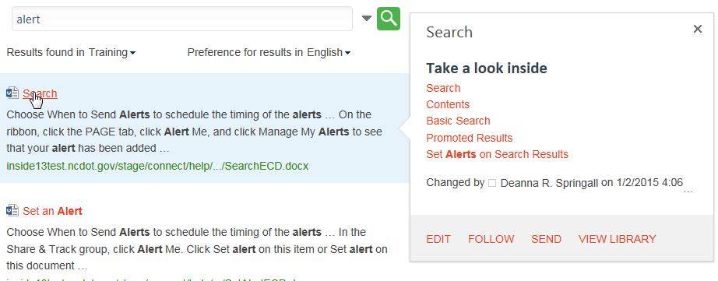
Basic Search Results
See details by hovering over the results

Slide 10
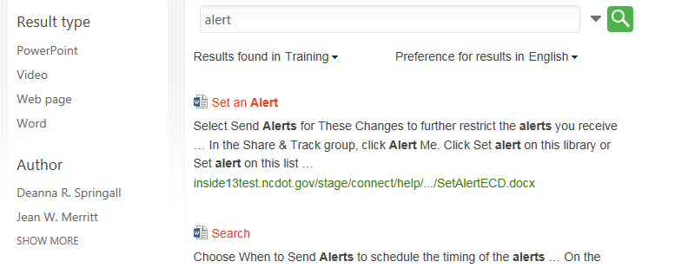
Refiners for Basic Search
Refiners are additional filters available on the initial search results page

Slide 11
Logical Operators
AND
set AND alert AND email
Results contain all three words in any order
OR
set OR an OR alert
Results contain any of the three words
NOT
set NOT alert
Results contain first word but not second word

Slide 12
Logical Operators
Quotation marks
“set an alert”
Results contain exact match - all words in that specific order
Wildcard (*)
aler*
Results contain any word that starts with aler, such as alert, alertly, alerts

Slide 13
Metadata Search
Metadata includes author, name, type, and title of the file
author:Jean W. Merritt
filename:EmailLinkPage
filetype:docx
Title:“Set, Edit and Delete an Alert on a Page”

Slide 14
Transportation Project Search
Uses a customized search interface
Searches the Project Store and construction team sites
Demonstrates importance of accurate metadata

Slide 15
Exercise 1 – Search
Go to the Contributor Class home page
Click Exercises for the links you’ll need

